Slide 1
Taiwan
Sign Language
Translation
Team: 王蕣婷 林于湘 林妘鑫 洪睿謙 陳郁婷 張育禔 楊畯棋 賴藍平
Presenter: 洪睿謙 陳郁婷

Slide 2
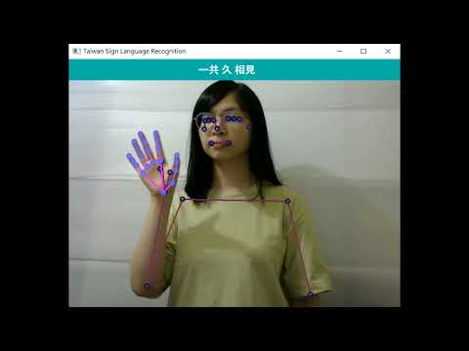
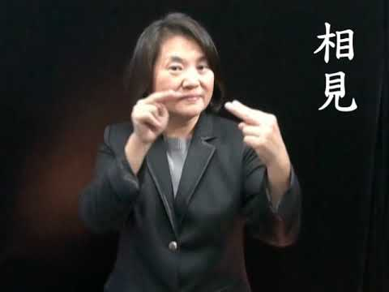
久/相見/ 無
=好久不見
Demo
2

Slide 3
Contents
01
02
03
04
TSL Translation
Introduction
Data & Methods
Why we started this project?
How to make this happen?
Experiments
Conclusion & Prospect
What have we done?
What’s next?
3

Slide 4
01
INTRODUCTION
TSL Translation
Motivation
Goal
4

Slide 5
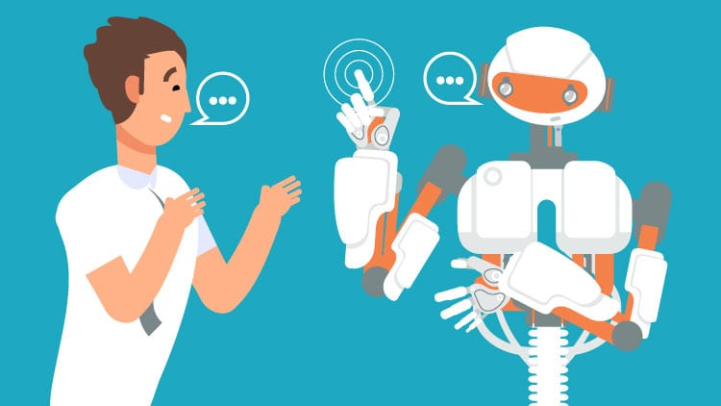
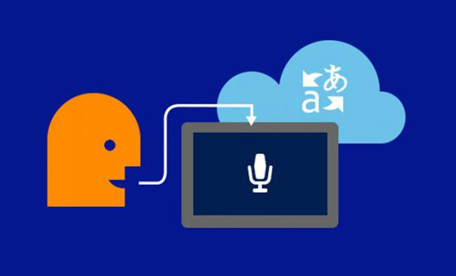
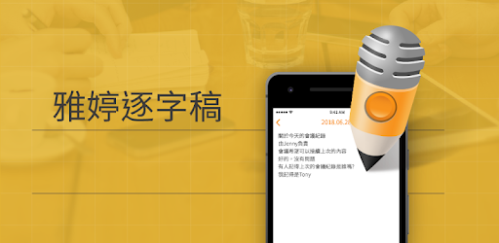
Motivation
Why not...
Introduction
5

Slide 6
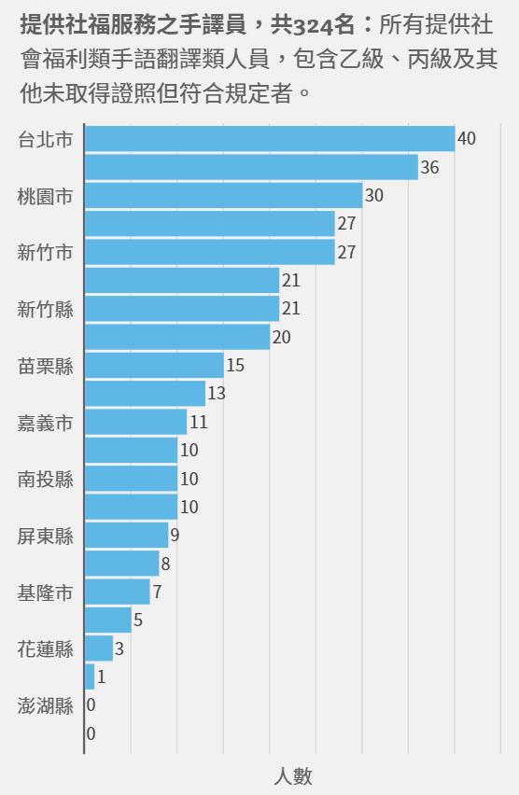
Motivation
Introduction
探究台灣手語翻譯服務現況，思考解決方案。期望改善使用者可能面臨的困境並提升生活品質與便利性。
人力缺口
培訓不易
專業門檻
場域限制
品質維護
城鄉落差
收入不穩
制度需求
6

Slide 7
Goal
TSL Translation
Introduction
Ordinary People
Interpreter
Deaf People
7

Slide 8
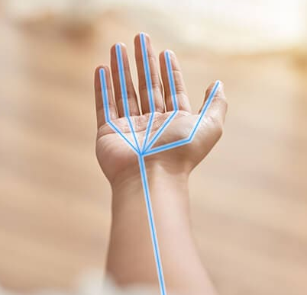

Goal
Introduction
手語隱含文化獨特性
語言系統與時俱進
Hand gesture recognition
Hand pose estimation & tracking
新技術＋AI ＝持續性的研究與學習價值
8

Slide 9
02
Data & Methods
TSL Translation
Taiwan Sign Language
Mediapipe Holistic
9

Slide 10
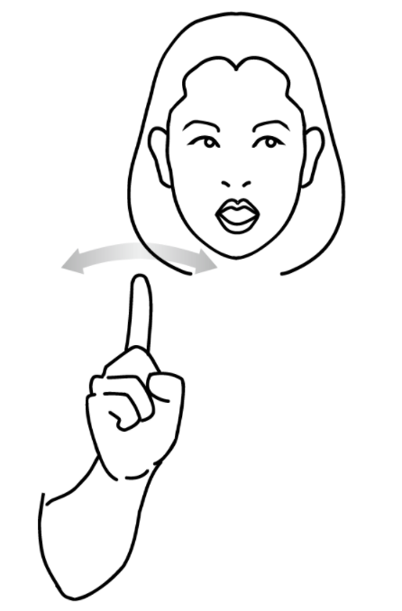
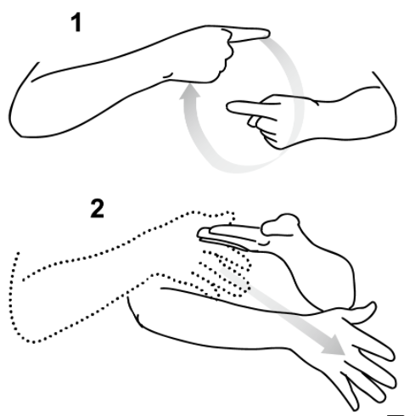
Data Collection
Data & Methods
手語是多重且連續性的資料，包含：
手形
位置
動作型態
方向
表情
10

Slide 11
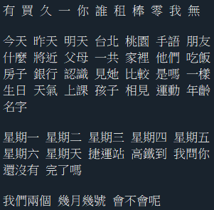
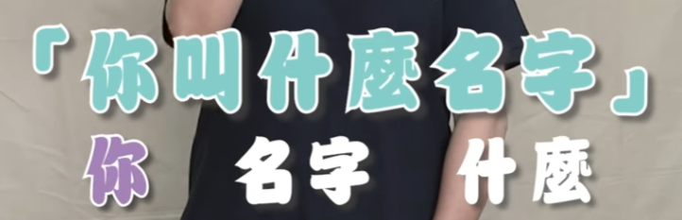
Data Collection
Data & Methods
來源 | 參考 Youtube 手語教學，自行拍攝
內容 | 涵蓋六大主題常用語 「年齡、問候、家人、時間、住家、描述」
筆數 | 共 55 個字詞，可組合至少 25 個短句
特徵 | 保留手形、位置（胸部以上）、動作型態及方向
11

Slide 12
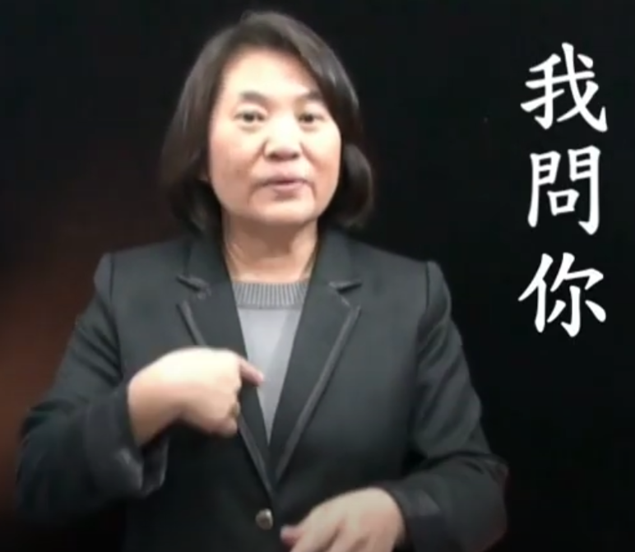
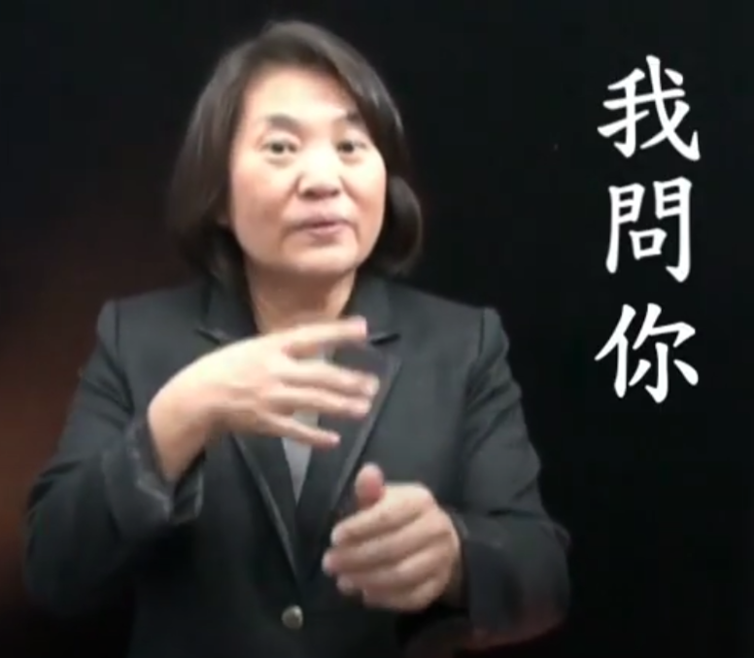
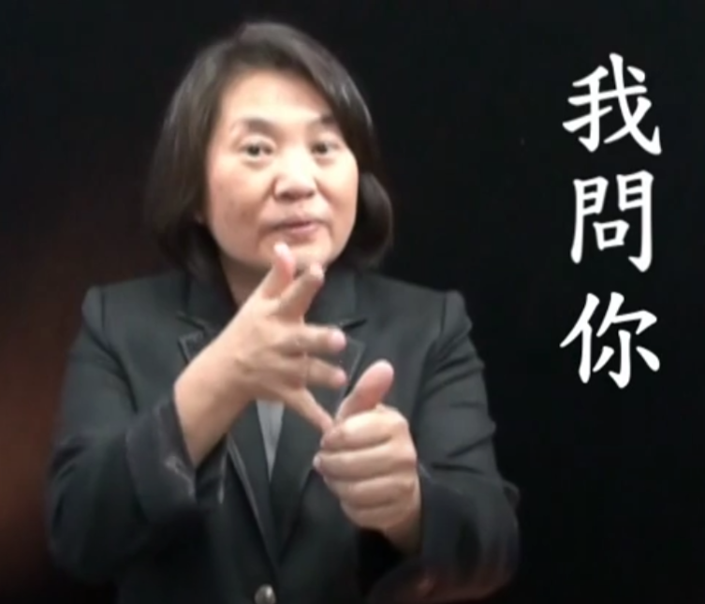
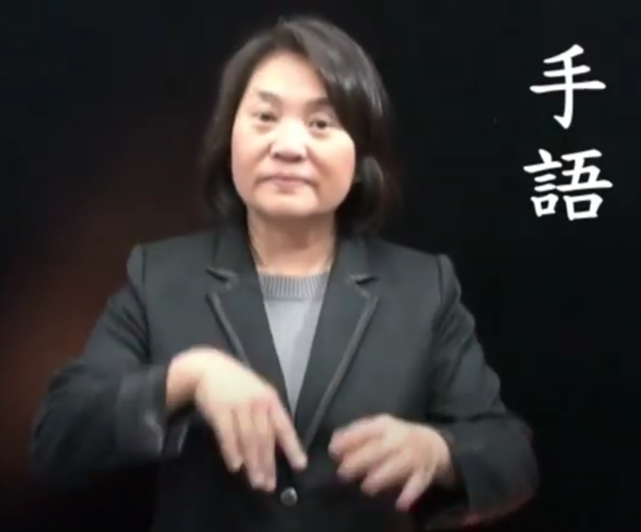
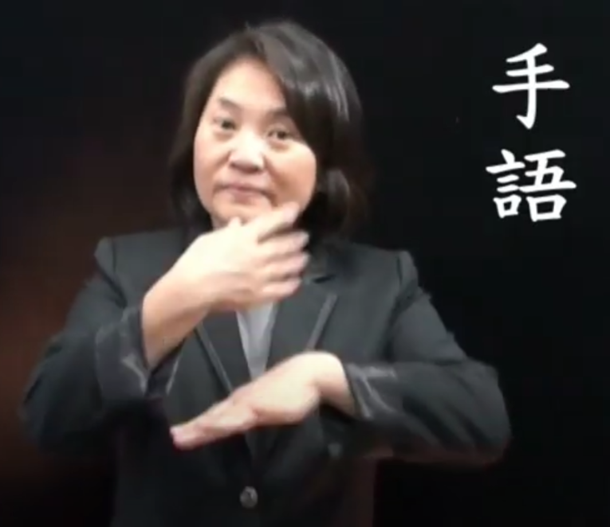
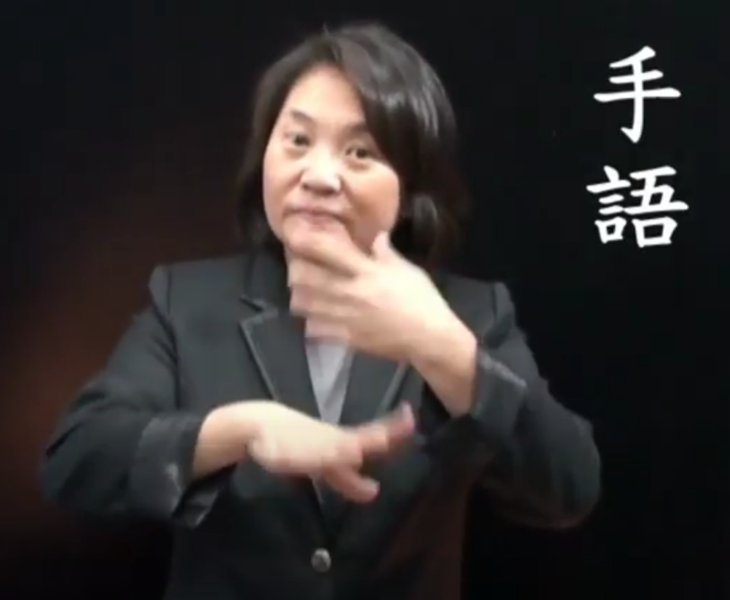
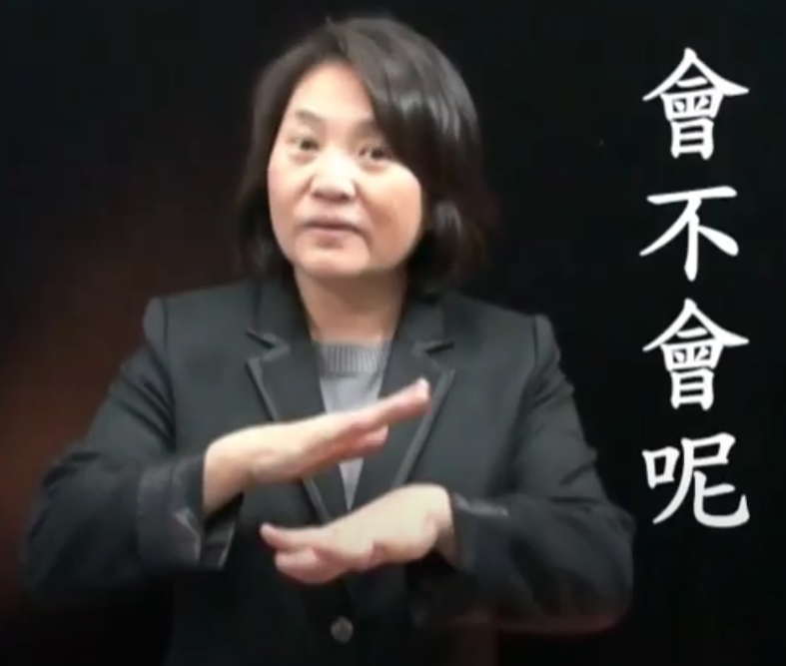
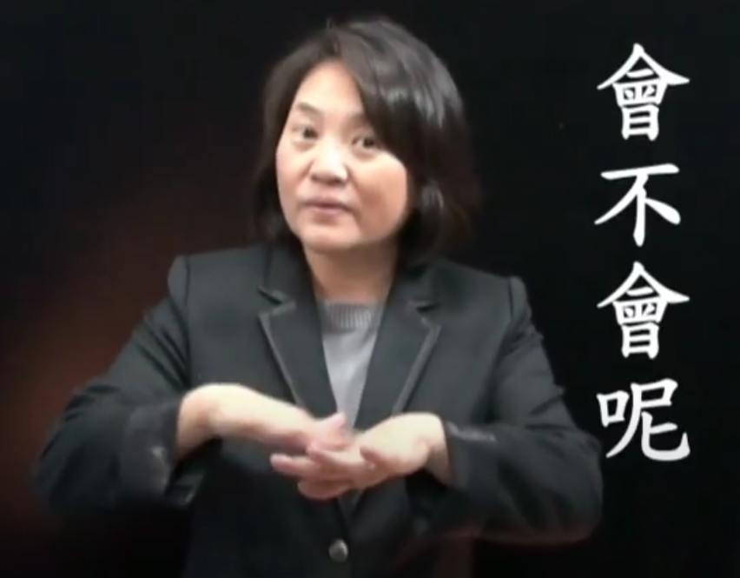
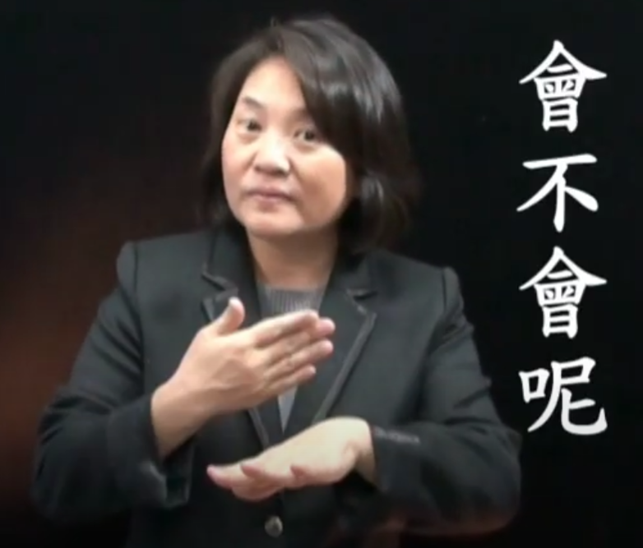
Data Collection
...
我問你/手語/會不會呢
＝ 請問你會不會打手語
...
55 words
60 frames (2 sec * 30 fps)
...
Data & Methods
我問你
手語
會不會呢
12

Slide 13
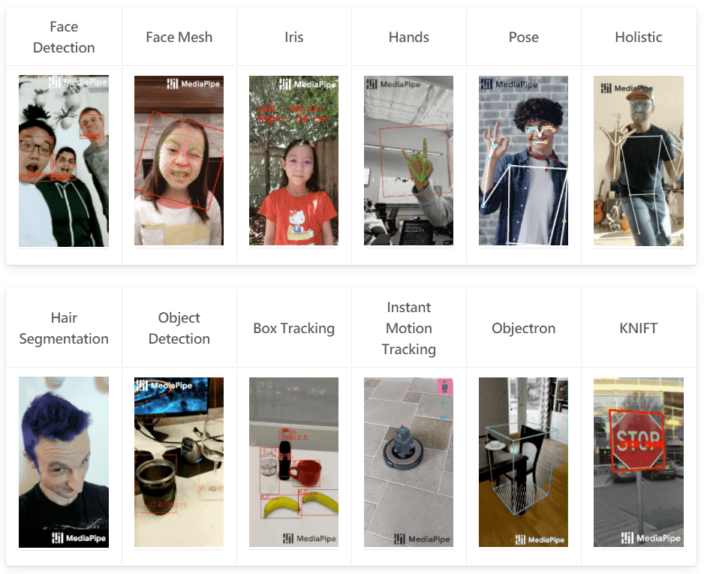
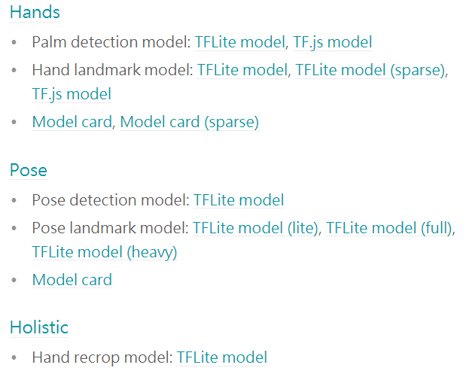

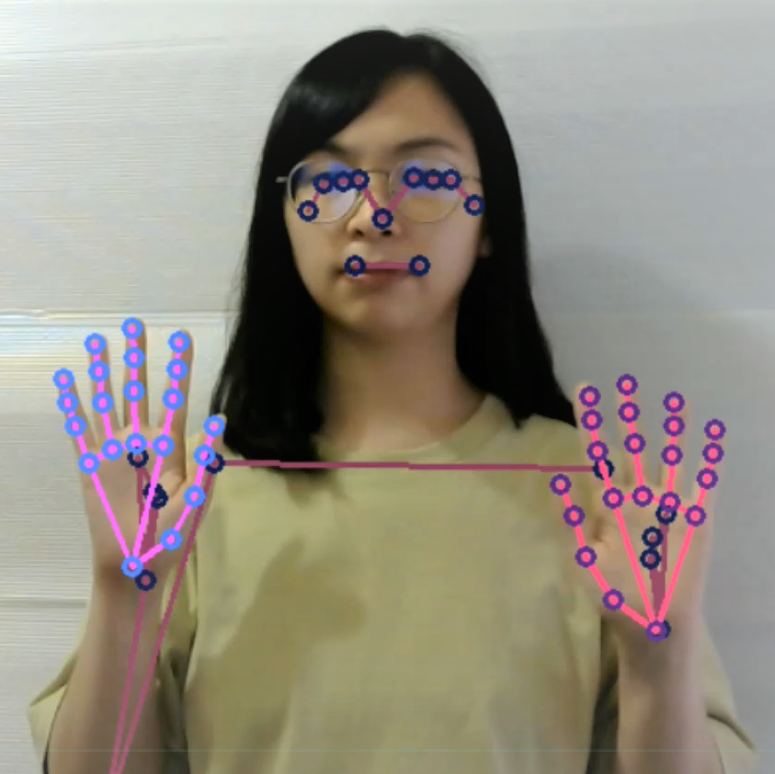
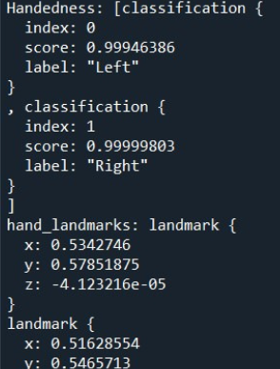
Hands & Pose Tracking Solution
Data & Methods
13

Slide 14


Data Preprocessing
Remove unused landmarks (face, pose 1~10, 23~32) and visibility
Keep 55 landmarks (right & left hands, pose 0, 11~22)
Each has xyz axis
55 * 3 = 165 features
Data & Methods
以鼻子為中心
轉換相對座標
14

Slide 15
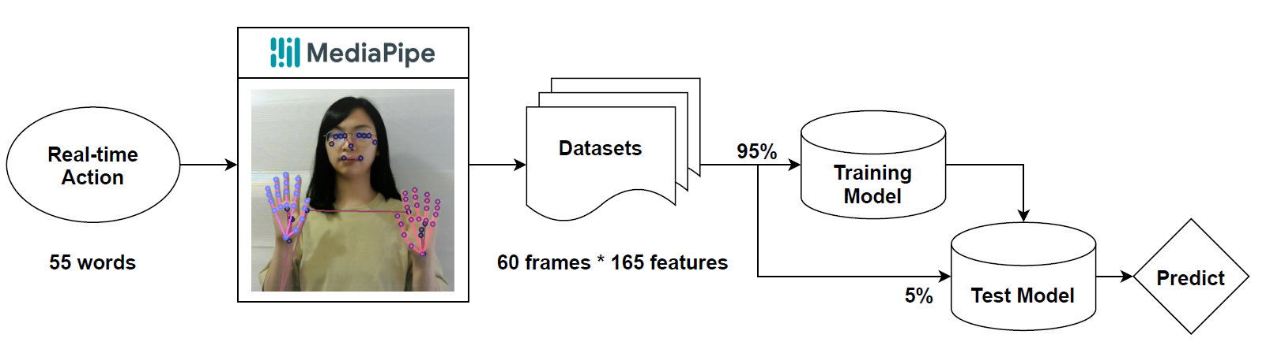
Workflow
Filming -----------> Array ---> AI Model --> Words
5 ppl
Data & Methods
15

Slide 16
03
EXPERIMENTS
TSL Translation
16

Slide 17
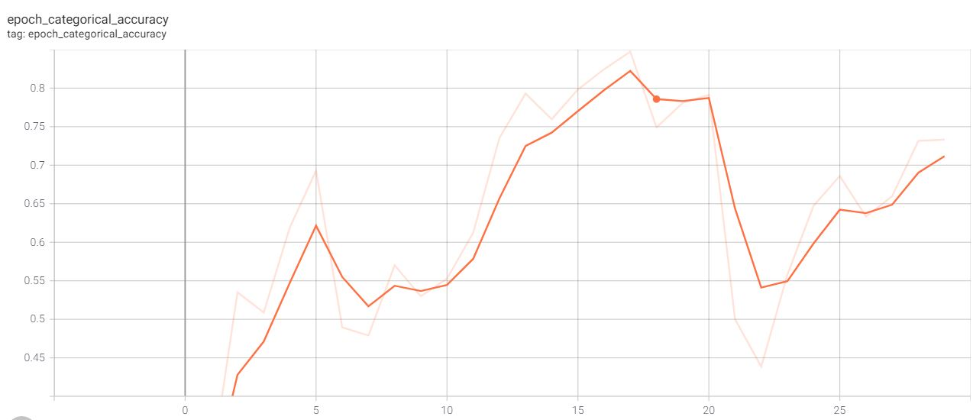
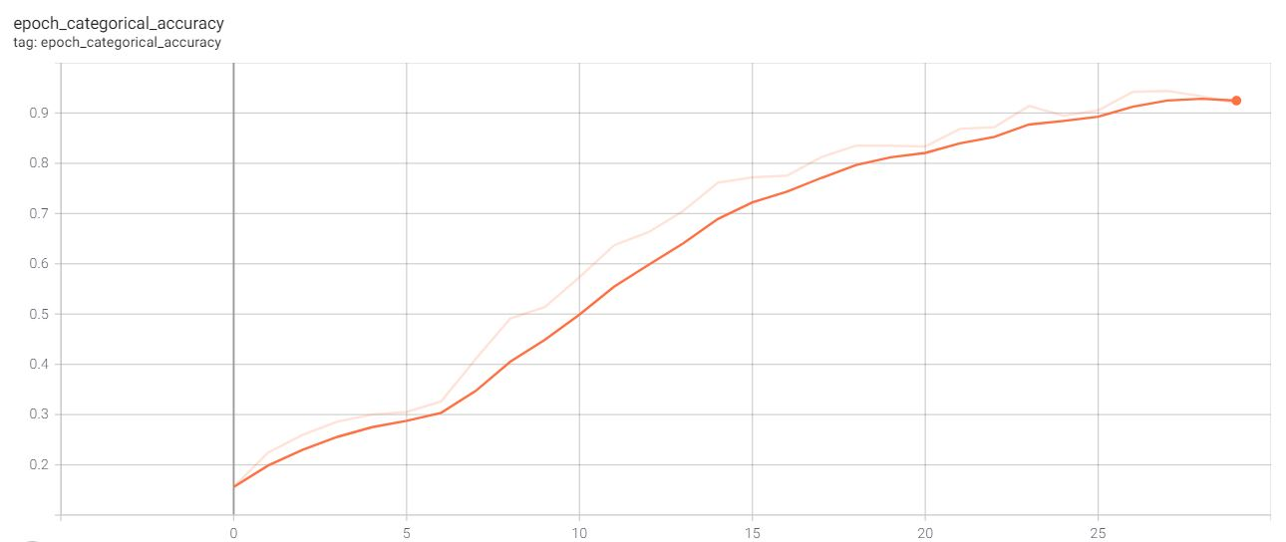
Our Journey Begins Here...
LSTM
GRU
accuracy
epoch
Experiments
Small datasets to test models (10 words)
Began with famous RNN model - LSTM
Turned to GRU model to increase speed
 | LSTM | GRU
Train accuracy | 0.7333 | 0.9193
Train loss | 0.7887 | 0.2065
Test accuracy | 0.7333 | 0.9000
Test loss | 0.8419 | 0.1724
17

Slide 18
Sticking with GRU...
Experiments
Bigger datasets based on GRU model
More
experiments
based on
GRU model
 | GRU-10 | GRU-55
Epoch | 30 | 75
Train accuracy | 0.9193 | 0.9573
Train loss | 0.2065 | 0.1321
Test accuracy | 0.9000 | 0.8909
Test loss | 0.1724 | 0.4429
Real-time test | 60% (6/10) | 42% (23/55)
18

Slide 19
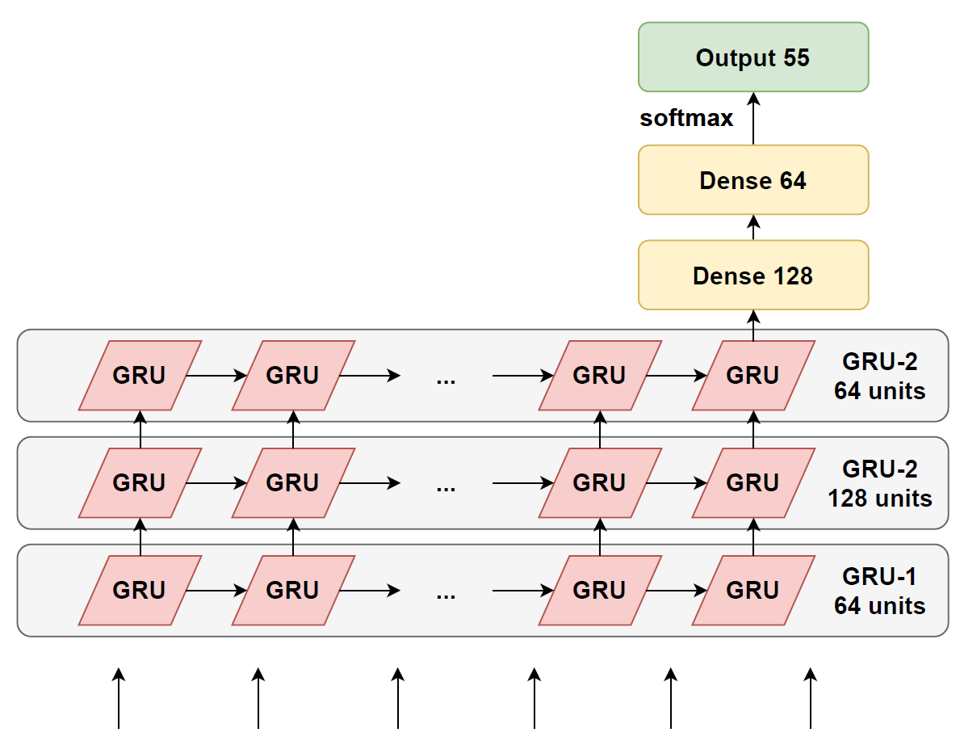
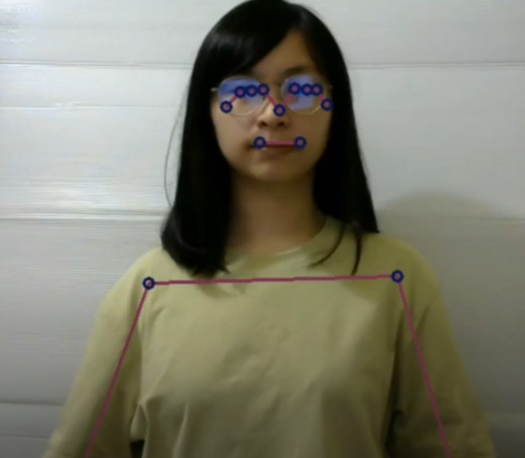
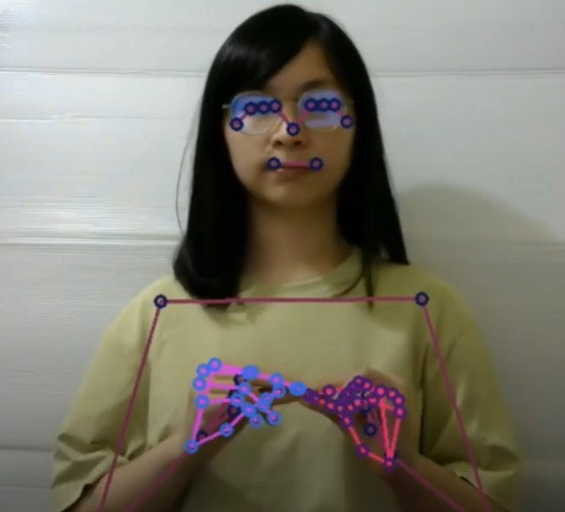
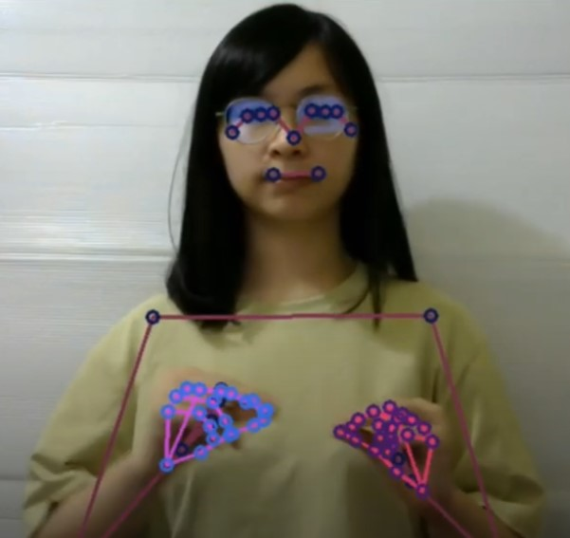
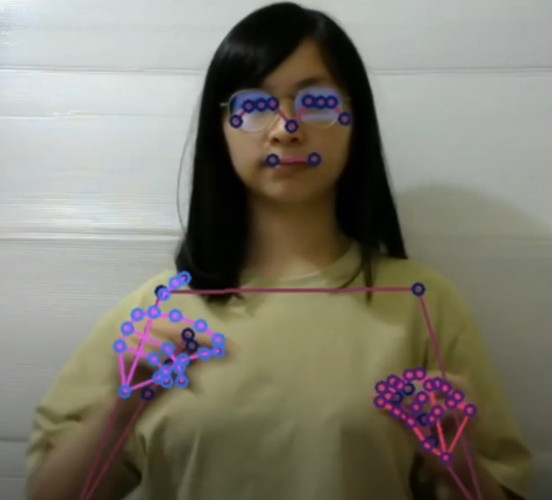
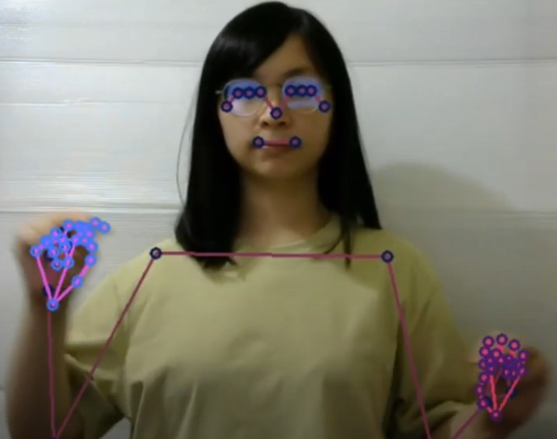
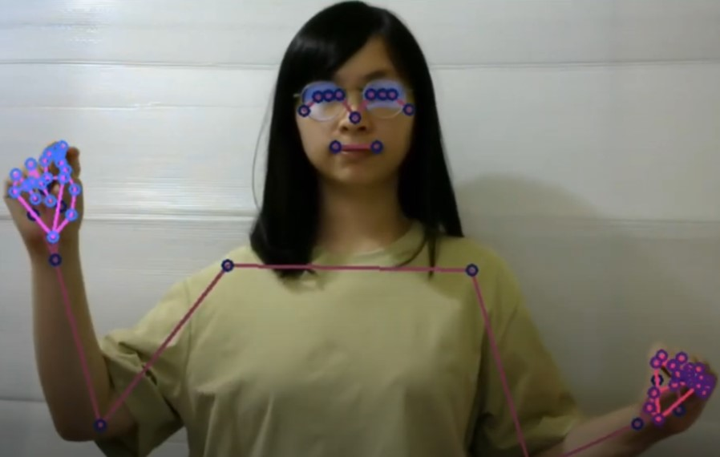
GRU Model Architecture
Experiments
Input shape (60, 165)
19

Slide 20

Experiments
Boss 1
GRU model no longer performs as well with 55 words
20

Slide 21
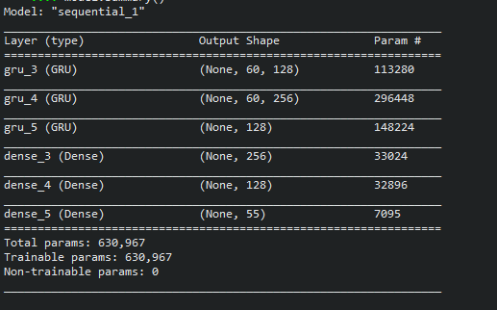
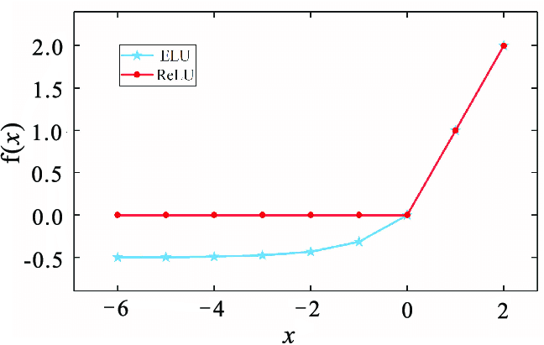
What have we done?
Experiments
Chose ELU instead of ReLU to preserve features
Discover negative numbers exists after transforming into relative coordinates
 | ReLU | ELU
Train accuracy | 0.9420 | 0.9910
Train loss | 0.1960 | 0.0420
Test accuracy | 0.8850 | 0.9330
Test loss | 0.3750 | 0.2030
Real-time test | 55% (30/55) | 67% (37/55)
21

Slide 22

Experiments
Discovered a BUG in Coordinate Transformation
BREAKING
NEWS
22

Slide 23

Experiments
Boss 2
Hand coordinates was not transformed into relative coordinate !!
23

Slide 24
What’s wrong?
Experiments
We looked into the data
 | ELU Old data | ELU New data?
Train accuracy | 0.9910 | 0.9911
Train loss | 0.0420 | 0.0389
Test accuracy | 0.9330 | 0.9333
Test loss | 0.2030 | 0.2127
Real-time test | 67% (37/55) | 51% (28/55)
24

Slide 25
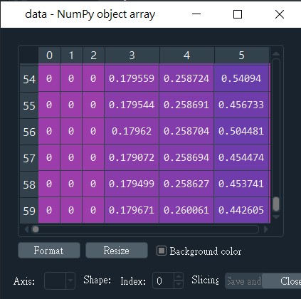
What’s wrong?
Experiments
When hand isn't detected it’ll be filled with 0
 | ELU Old data | ELU New data?
Train accuracy | 0.9910 | 0.9911
Train loss | 0.0420 | 0.0389
Test accuracy | 0.9330 | 0.9333
Test loss | 0.2030 | 0.2127
Real-time test | 67% (37/55) | 51% (28/55)
24

Slide 26
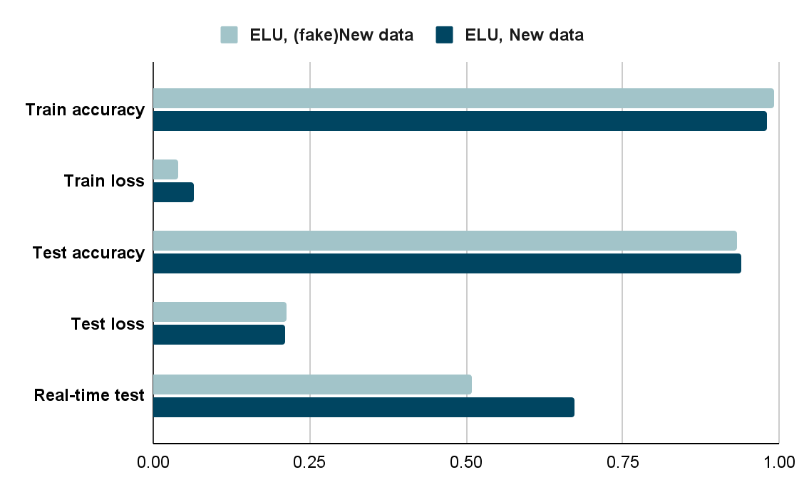
What have we done?
Experiments
Implemented mask to preserve “0”
Only keep the results where the value is true (0 - nose = obtain value)
 | ELU New data ? | ELU New data (0)
Train accuracy | 0.9911 | 0.9810
Train loss | 0.0389 | 0.0640
Test accuracy | 0.9333 | 0.9390
Test loss | 0.2127 | 0.2110
Real-time test | 51% (28/55) | 67% (37/55)
False
True
Mask
25

Slide 27
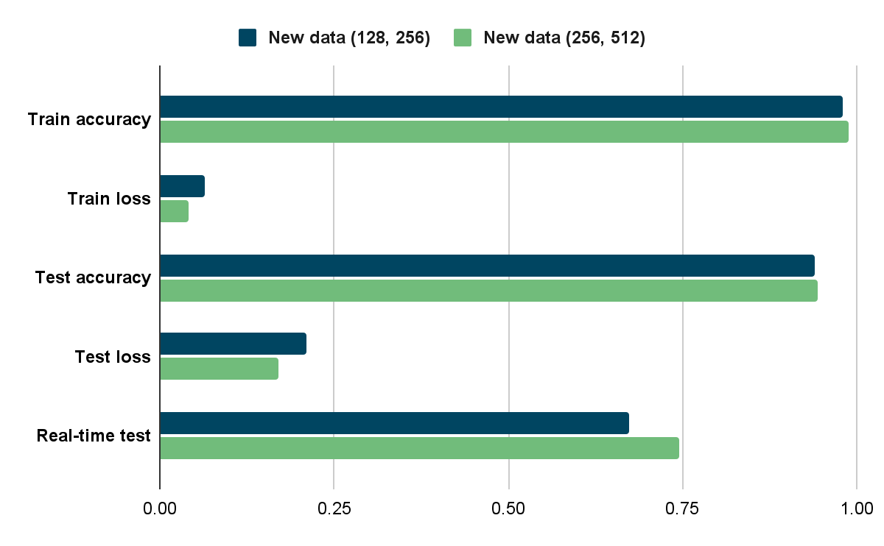
Tuning Model
Experiments
Increase model size (add to GRU 256,512)
 | New data (128, 256) | New data (256, 512)
Train accuracy | 0.9810 | 0.9880
Train loss | 0.0640 | 0.0410
Test accuracy | 0.9390 | 0.9450
Test loss | 0.2110 | 0.1700
Real-time test | 67% (37/55) | 75% (41/55)
26

Slide 28

Experiments
Boss 3
Ceiling: reach the maximum potential
27

Slide 29
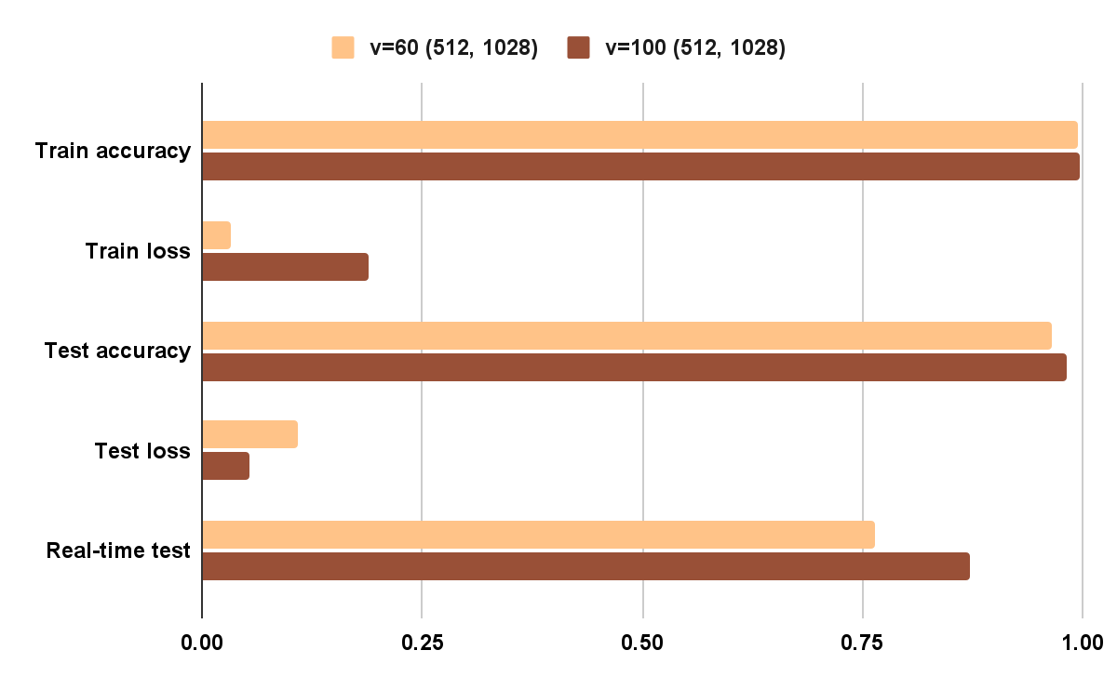
What have we done?
Experiments
Increase model size (add to GRU 512,1028)
Increase number of videos (add to 100)
 | v=60 (512, 1028) | v=100 (512, 1028)
Train accuracy | 0.9940 | 0.9970
Train loss | 0.0320 | 0.1890
Test accuracy | 0.9650 | 0.9820
Test loss | 0.1090 | 0.0530
Real-time test | 76% (42/55) | 87% (48/55)
28

Slide 30
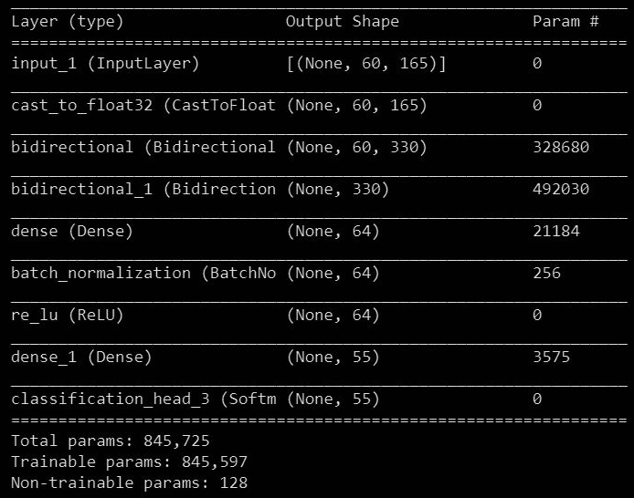
Hyperparameters Fine Tuning
Experiments
Used AutoKeras instead of grid search
RNNBlock
autokeras.RNNBlock(return_sequences=False, bidirectional=None, num_layers=None, layer_type=None)
DenseBlock
autokeras.DenseBlock(num_layers=None, num_units=None, use_batchnorm=None, dropout=None)
29

Slide 31
Hyperparameters Fine Tuning
Experiments
Used AutoKeras instead of grid search
 | v=100 (512, 1028) | AutoKeras
Train accuracy | 0.9970 | 0.9991
Train loss | 0.189 | 0.0270
Test accuracy | 0.982 | 0.9927
Test loss | 0.053 | 0.0504
Real-time test | 87% (48/55) | 95% (52/55)
29

Slide 32
04
CONCLUSION & PROSPECT
TSL Translation
30

Slide 33
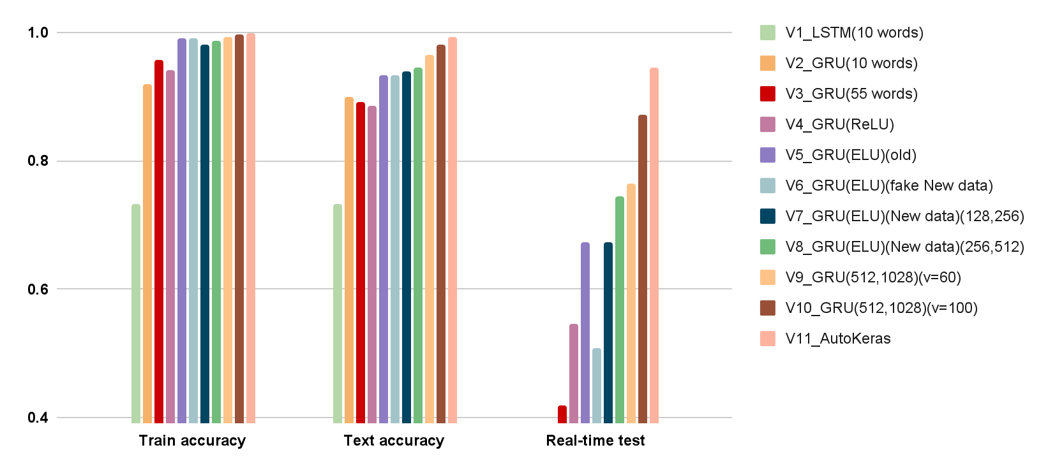
Review: Comparison of All Model
Conclusion & Prospect
31

Slide 34
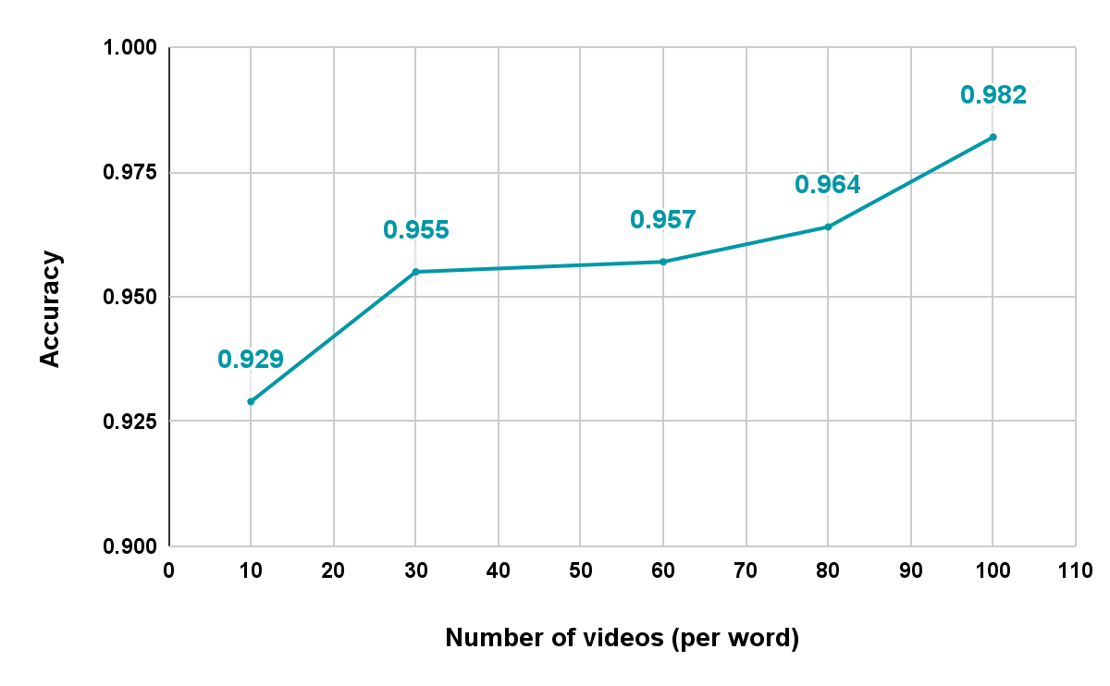
Review: Comparison of Datasets
Conclusion & Prospect
More words More videos
32

Slide 35
Conclusion
Conclusion & Prospect
AutoKeras outperforms V10 (GRU 512) on all numerical aspects
Currently V10 has the upper hand in terms of real-time due to technical difficulties (time)
33

Slide 36
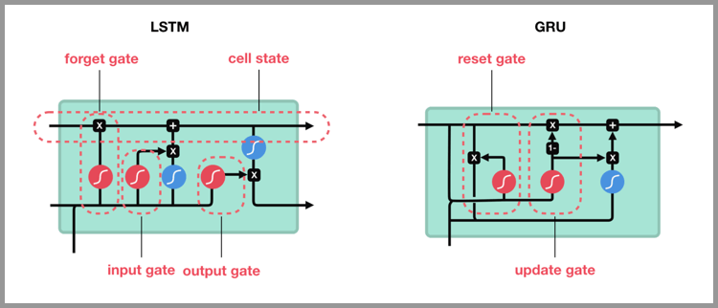
Conclusion
Conclusion & Prospect
GRU performs better on smaller datasets
34

Slide 37
Comparable with previous TSL project
Conclusion & Prospect
 | Previous | Ours
Words | 7 | 55
Number of videos | 200 | 100
Frames | 90 | 60
Model | LSTM | GRU
Best test accuracy | 0.9963 | 0.9927
Real-time test:
95% (52/55)
35

Slide 38
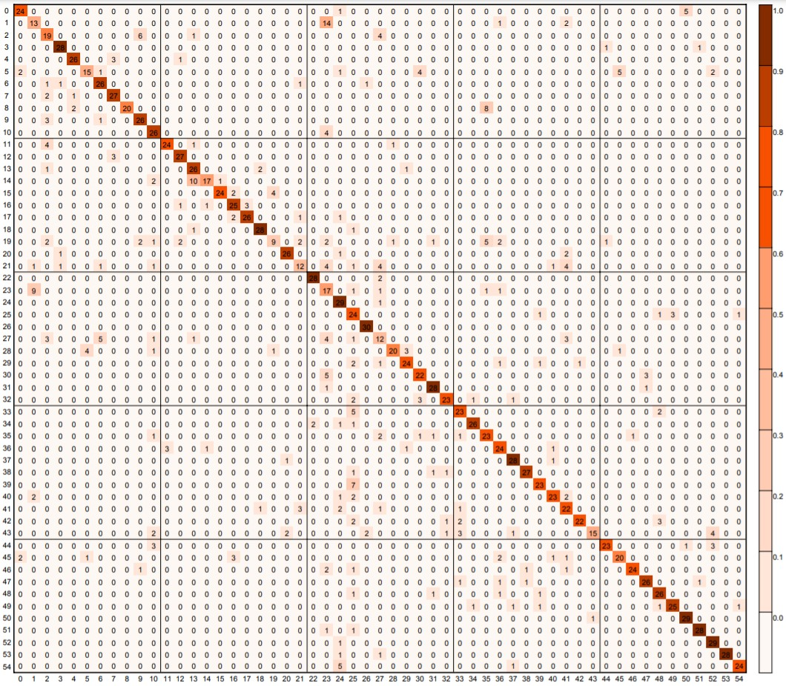
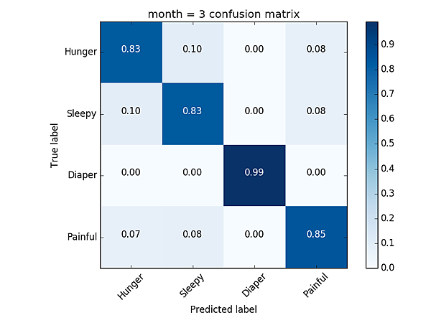
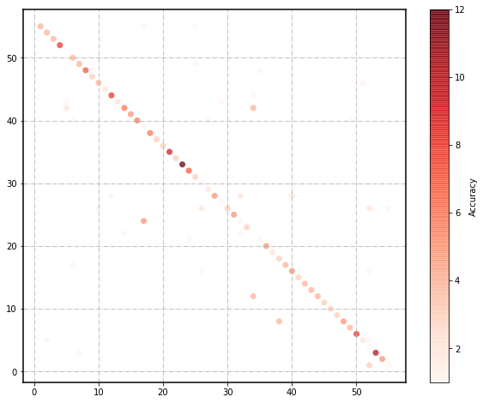
Confusion Matrix
Conclusion & Prospect
36

Slide 39
Prospect
Conclusion & Prospect
Education
Ordinary People
Interpreter
Deaf People
NLP
Bert
TTS
Markov
HMI
AIOT
Domain Knowledge
37

Slide 40
Thanks!
TSL Translation
Taiwan Sign Language Translation
王蕣婷 林于湘 林妘鑫 洪睿謙 陳郁婷 張育禔 楊畯棋 賴藍平
CREDITS: This presentation template was created by Slidesgo, Flaticon, Freepik and Storyset

